Slide 1
Lecture 6 – Model-Based Requirements
Documentation
Requirement Engineering
Book Pohl, Klaus. Requirements engineering: fundamentals, principles, and techniques.
Fast-National University of computer & Emerging Sciences

Slide 2
Effects of Natural Language
Three types of requirements are documented independently and used in conjunction:
Goals describe intentions of stakeholders or groups of stakeholders. Goals can potentially conflict with one another.
Use cases and scenarios document exemplary sequences of system usage. Scenarios are grouped together in use cases.
System requirements (generally referred to as requirements) describe detailed functions and qualities that the system to be developed shall implement or possess. In addition, system requirements provide complete and precise information to serve as input for subsequent development steps.

Slide 3
Term Models
Models as abstracting images from reality
Definition : Model
A model is an abstract representation of an existing reality or a reality to be created.
Modeling may be applied to material or immaterial objects of an existing reality or a reality to be developed.

Slide 4
Properties of Models
Every model possesses three important properties that are also the prevalent advantages of models:
Mapping of reality:
Every model maps certain aspects of the observed reality onto its modeling elements.
Model creation can be descriptive and prescriptive in nature. In the case of descriptive model construction, the resulting model documents the existing reality.
In the case of prescriptive model construction, the resulting model serves as a prototype for a fictitious reality.
Depending on the perspective, models themselves can be both descriptive and prescriptive at the same time.
For example, a model is descriptive with regard to the conception of the stakeholder who is constructing it and prescriptive with regard to the system to be developed.

Slide 5
Properties of Models
Reduction of reality:
Models reduce the mapped reality. It is common to differentiate between selection and compression.
During selection, only particular aspects that are part of the universe of discourse of the system are modeled. In contrast, aspects of the subject-matter of the system are summarized during compression.
Pragmatic property:
A model is always constructed for a special purpose and within a special context.
The purpose of the model may affect the construction and the purpose-driven reduction of reality within the models. Ideally, a model contains only the information necessary for the respective purpose.
Typically, graphical models are used in requirements engineering. Their modeling elements are conceptualizations of material or immaterial objects, or people, in reality.

Slide 6
Modeling Languages
Syntax and semantics
In order to construct conceptual models, specific modeling languages are used. A modeling language is defined by its syntax and semantics:
Syntax: The syntax of a modeling language defines the modeling elements to be used and specifies the valid combinations thereof.
Semantics: The semantics defines the meaning of the individual modeling elements and serves therefore as a foundation for the interpretation of the models of the respective modeling language

Slide 7
Modeling Languages
Different degrees of formalization
Conceptual modeling languages can be classified as formal, informal, and semiformal, depending on the degree of formalization.
The degree of formalization of a modeling language depends on the magnitude of formal definitions (e.g., mathematical calculus) that define the syntax and semantics.

Slide 8
Modeling Languages
Requirements Models
Conceptual models that document the requirements of a system are called requirements models. The Unified Modeling Language (UML) is frequently used to construct requirements models.
It consists of a set of partially complementary modeling languages that are particularly used in requirements engineering to model the requirements of a system from different perspectives.
Requirements models vs. design models
The difference between the conventional use of conceptual models in system development and model usage for requirements documentation is that conventional models document solutions chosen during system development. Requirements models, on the other hand, depict specific aspects of the underlying problem.

Slide 9
Advantages of Requirements Models
Increased understandability : Research on human cognition has shown that information can be perceived and memorized faster and better when depicted graphically as opposed to making use of natural language.
Support perspectives of documentation : An additional advantage when using requirements models is that in contrast to natural language, the modeling languages used have a strictly defined focus. An example is the different kinds of maps that can be drawn for a city.
Requirements models also have the advantage that the different types of modeling elements within the same modeling language dictate the method of abstraction as well as what is being abstracted and what is not.

Slide 10
Properties of Models
Combined Use of Models and Natural Language
Using both natural language and requirements models in combination allows the advantages of both documentation techniques to be exploited while minimizing their disadvantages.
For example, natural language requirements can be summarized and their interrelations depicted using models.
On the other hand, natural language can help enrich requirements models and modeling elements with additional information.

Slide 11
Goal Models
The positive impact on requirements engineering—if goals are modeled—and on the quality and comprehensiveness of the requirements is very high.
Goals are a stakeholder’s (e.g., a person’s or an organization’s) description of a characteristic property of the system to be developed or the development project.
Natural-language-based and model-based documentation
Goals are very well suited to refine the vision of the system. Refining a goal is known as goal decomposition. Goals can be documented using natural language (e.g., by means of predesigned templates) or using goal models.
A widely known and very common goal modeling technique is the use of AND/OR trees. By means of AND/OR trees, hierarchical decompositions can be documented.
The type of refinement relation is depicted by graphic representations of the branches. The direction of the goal decomposition is not represented through branches but through the top-down structure of the tree.

Slide 12
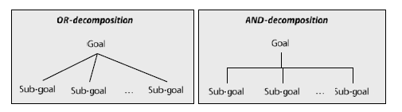
Goal Models
Goal Documentation Using AND/OR Trees
Using AND/OR trees, two types of decomposition relationships can be distinguished.
AND-decomposition vs. OR-decomposition
With regard to decomposition relations, one can differentiate between AND-decomposition and OR-decomposition.
In case of AND-decomposition, every sub-goal must be fulfilled so that the super-goal (the root) is fulfilled.
In contrast, in OR-decomposition, it suffices if at least one subgoal is fulfilled so that the super-goal is met.

Slide 13
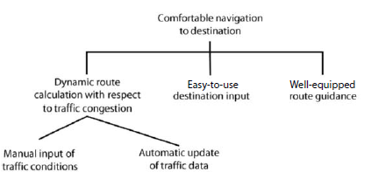
Goal Models
Example of AND/OR Trees
An AND/OR tree that documents the hierarchical decomposition of the goal “Comfortable navigation to destination”.
As the goal model, the goal “comfortable navigation to destination” is refined into the three sub-goals “dynamic route calculation with respect to traffic congestion”, “comfortable destination input”, and “comfortable route guidance” via AND-decomposition.

Slide 14
Goal Models
This depicts that all three sub-goals must be met to consider the super-goal fulfilled. The sub-goal “dynamic route calculation with respect to traffic congestion” in turn is refined by the two sub-goals “manual input of traffic conditions” and “automatic update of traffic data”.
The type of decomposition relation depicts that only one of the two sub-goals must be met to consider the super-goal met.

Slide 15
Use Cases
Use cases were first proposed in [Jacobson et al. 1992] as a method to document the functionalities of a planned or existing system on the basis of simple models.
The use case approach is based on two concepts that are used in conjunction with one another:
Use case diagrams
Use case specifications

Slide 16
Use Cases
UML Use Case Diagrams
Relations between use cases. Use case diagrams in the UML are simple models to schematically document the functions of a system from a user’s perspective and to document the interrelations of the functions of a system and the relations between these functions and their environment

Slide 17
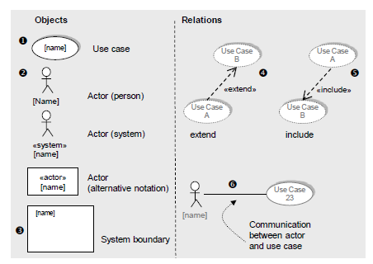
Use Cases
Modeling Elements of UML Use Case Diagrams
Essential Elements:
Use cases
Actors
System boundaries
Extend relation
Include relation
Relation between actors
and use cases

Slide 18
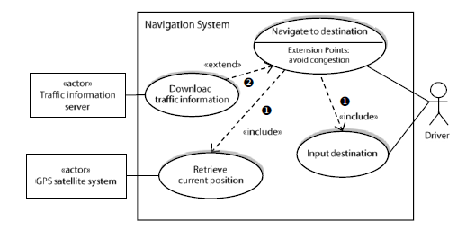
Use Cases
Example

Slide 19
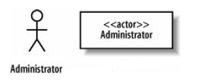

Example
The requirement indicates that that the Administrator interacts with the system to create a new blogger's account
Requirement 1
The content management system shall allow an administrator to create a new blog account, provided the personal details of the new blogger are verified using the author credentials database.
The
Administrator interacts with the system and is not part of the system; thus, the Administrator
Is an Actor.
It's actually worth being very careful when naming your actors. The best approach is to use a name that can be understood by both your customer and your system designers.

Slide 20

Example
What can be the use case in our Requirement 1?
to create a new blog account
Requirement 1
The content management system shall allow an administrator to create a new blog account, provided the personal details of the new blogger are verified using the author credentials database.
UML Representation

Slide 21
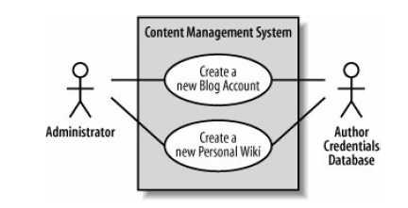
Example (Cont)
Requirement 2
The content management system shall allow an administrator to create a new personal Wiki, provided the personal details of the applying author are verified using the Author Credentials Database.

Slide 22
Use Case Specification
Use case diagrams show the system’s relevant functions from a user’s perspective and specific relationships between the functions of the system or between functions of the system and aspects in the system’s context.
With the exception of a use case’s name and its relationships, use cases diagrams do not document any information about the individual use cases such as the systematic interaction between a use case and an actor.
This information is documented textually by means of adequate templates in conjunction with use case diagrams.

Slide 23
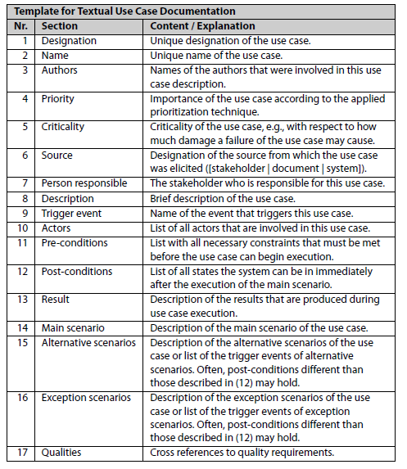
Use Case Specification
Reference templates for the
documentation of use cases
Templates define types of information that should be documented for a use case and suggest an appropriate structure for the information

Slide 24
Use Case Specification
Attributes for unique identification of use cases (rows 1 and 2)
Management attributes (rows 3 through 7)
Attribute for the description of the use case (row 8)
Specific use case attributes, e.g., the trigger event (row 9), actors (row 10), pre- and post-conditions (rows 11 and 12), the result of the use case (row 13), the main scenario (row 14), alternative and exception scenarios (rows 15 and 16), and cross references to quality requirements (row 17)

Slide 25
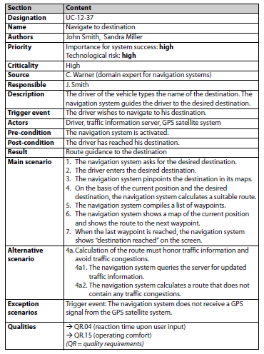
Use Case Specification
Example of template-based
documentation of a use case

Slide 26
Three Perspectives on the Requirements
Data perspective: In this perspective, the structures of input and output data as well as static-structural aspects of the usage and dependency relationships of the system in the system context are documented. This way, requirements aspects that pertain to the static structure can be modeled using UML class diagrams, for instance.
Functional perspective: This perspective documents which information of the system context is being manipulated by the system to be developed and which data is being transmitted to the system context by the system. Requirements in the functional perspective can be modeled using UML activity diagrams

Slide 27
Three Perspectives on the Requirements
Behavioral perspective: The embedding of the system in the system context is documented on the basis of states in this perspective. This is done, for instance, by documenting the reaction of the system to events within the system context, documenting the conditions that trigger a state change, or documenting the effects that the system has on its environment. Requirements in the behavioral perspective can be modeled using state charts.
Perspectives are not disjoint.
Certain aspects of the models of a particular perspective can also be found in other perspectives. The three perspectives are therefore not disjoint.
For example, the data, whose static structure is defined in a UML class diagram can potentially also be found in the functional perspective because it depicts the inputs and outputs of actions in a UML activity diagram.
As the three perspectives are not disjoint, the models can be reciprocally checked for completeness and consistency with regard to the information that is modeled at the intersections.

Slide 28
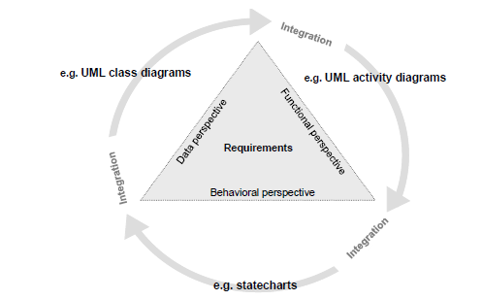
Three Perspectives on the Requirements

Slide 29
Requirements Modeling in the Data Perspective
Commonly, entity-relationship models, extensions of the traditional entity-relationship model according to Chen [Chen 1976.], and, increasingly, class diagrams of the UML (e.g., [Rumbaugh et al. 2005]) are used as requirements models of the data perspective.
Entity-Relationship Diagrams
Class Diagram

Slide 30
Requirements Modeling in the Data Perspective
Entity-Relationship Diagrams
The traditional entity relationship model are used for modeling the data perspective because they display the structure of an object of an universe of discourse by means of entity types and relation types
Extensions of the entity relationship model mainly concern the generalization/specialization relations, inheritance mechanisms, and roles of entities and extend the model by a (min, max)-notation for cardinalities of relations.

Slide 31

Requirements Modeling in the Data Perspective
Modeling Elements of Entity-Relationship Diagrams
Classification: abstraction from concrete objects : Entity types
Abstraction from concrete relationships : Relation type
Properties of entity types and relation types : Attribute type
Number of relation instances : Cardinalities

Slide 32
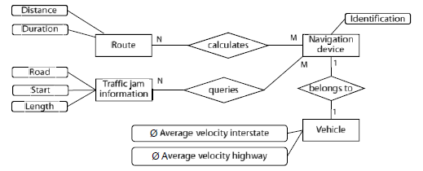
Requirements Modeling in the Data Perspective
Example of Entity-relationship diagram (data model) according to Chen

Slide 33
Requirements Modeling in the Data Perspective
UML Class Diagrams
Static perspective: data/ structure
Class diagrams of the UML can be used to model the data perspective of requirements of a system to be developed as well.
A class diagram consists of a set of classes and associations between classes.
Classes and associations in UML class diagrams are similar to entity types and relation types in entity-relationship diagrams.
Class models possess additional modeling elements (e.g., that allow for the specification of valid operations on the instances of a class) and thus have a greater power of description.

Slide 34
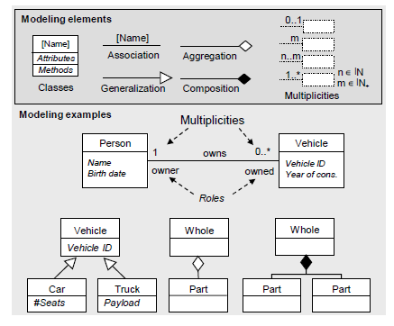
Requirements Modeling in the Data Perspective
Modeling Elements of Class Diagrams
Classes
Associations, multiplicities,
and roles
Aggregation and composition
Generalization

Slide 35
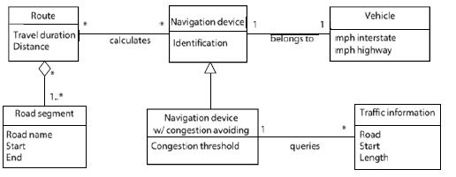
Requirements Modeling in the Data Perspective
Example Class diagram in UML notation

Slide 36
Difference between Aggregation and Composition
Aggregation is one type of association between two objects describing the “have a” relationship while Composition is a specific type of Aggregation which implies ownership.
Aggregation is indicated using a straight line with an empty arrowhead at one end. On the other hand, the composition is indicated using a straight line with a filled arrowhead at any one of the ends.
In an aggregation relationship, objects that are associated with each other can remain in the scope of a system without each other. But in a composition relationship, objects that are associated with each other cannot remain in the scope without each other.
In Aggregation, linked objects are not dependent upon the other object whereas in composition, objects are highly dependent upon each other.

Slide 37
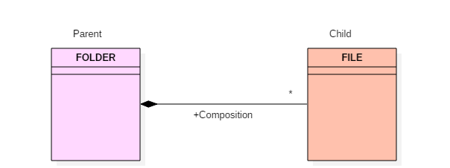
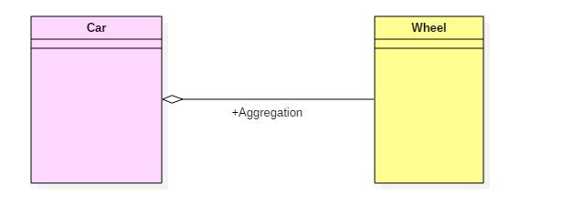
Examples
Example of Composition
The folder could contain many files, while each File has exactly one Folder parent. If a folder is deleted, all contained files are removed as well. In a composite aggregation, an object may be a part of only one composite at a time.
Example of Aggregation
A car needs a wheel to function correctly. However, we cannot say the same with a car. The same logic can be applied to bike, bicycle, or any other vehicle but not a particular car. Here, the wheel object is meaningful even without the car object. It is known as an aggregation relationship.

Slide 38
Class Activity
Goal Model
Entity Relationship Diagram
Use Cases
Class Diagram
Hotels are the place where you stay, eat meals and utilize their other services. As computer has merged with man as single entity so a computerized application can be developed that can handle Hotel Management System (HMS). Various activities take place in hotel like Hotel needs to maintain the record of guests and reserve rooms beforehand. Customers should be able to know the availability of the rooms on a particular date. They should be able to reserve the available rooms according to their need in advance. To make their stay comfortable, they are provided with food and other services. The record of the food taken by each customer and the services availed by the customer should be kept. These records help in generating bill. All the above activity takes place manually, manually carrying out this activity in very tedious time consuming. As we have tried to develop computerized application so as to handle all the activity that takes place in Hotel. As all the activities that happen in the Hotel such as enquiry, check status booking, food order etc. can be handled on this system simultaneously.

Slide 39
Requirements Modeling in the Functional Perspective
The functional perspective of requirements deals with the transformation of input data received from the environment into output data released into the environment of the system.
There are a number of different model-based approaches that can be used to model the functional perspective of requirements. The majority of these techniques is based on the structured system analysis approaches such as the structured analysis or the essential system analysis.

Slide 40
Requirements Modeling in the Functional Perspective
Data Flow Diagram
At the center of attention of modeling requirements from a functional perspective are diagrams that model the functionality of the respective system by means of processes (functions), data stores, sources, and sinks in the system environment as well as data flow.
A commonly used type of functional models are data flow diagrams, as suggested
in the structured analysis according to [DeMarco 1978]. Data flow models allow modeling the system on different levels of abstraction.

Slide 41

Requirements Modeling in the Functional Perspective
Modeling Elements of Data Flow Diagrams
Data manipulation
Resting data
Objects in the system environment
Flowing data

Slide 42
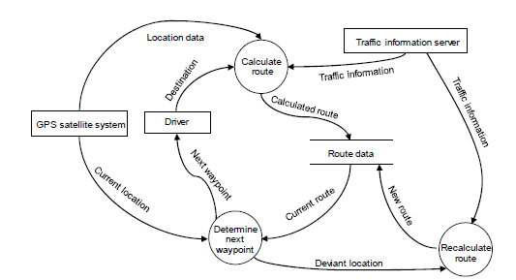
Requirements Modeling in the Functional Perspective
Example Data flow diagram in the notation suggested by DeMarco

Slide 43
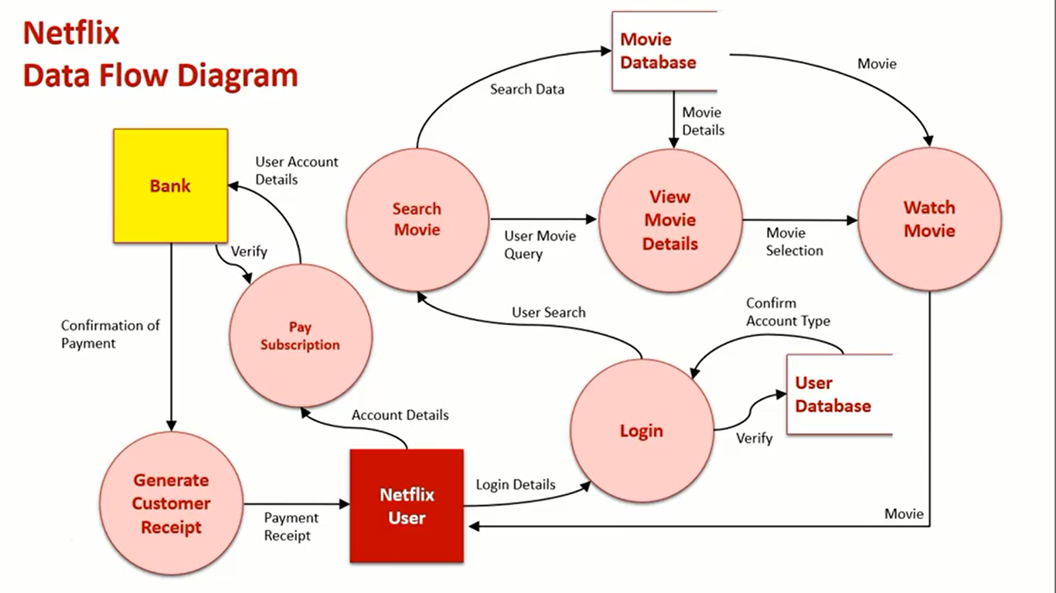

Slide 44
Requirements Modeling in the Functional Perspective
Models of the Functional Perspective and Control Flow
In data flow diagrams, it cannot be seen which conditions trigger which processes.
Data flow diagrams merely depict data dependencies of the processes in a system and document necessary input and generated output data. Approaches used in structured system analysis, however, often offer complementary behavioral descriptions and control flow descriptions.
This is achieved either by using distinct documentation forms, such as mini-specifications in structured analysis, or by means of implicit language extensions of data flow models. Language extensions offer the ability to model additional aspects, e.g., the control flow between functions, as done in SA/RT

Slide 45
Requirements Modeling in the Functional Perspective
UML Activity Diagrams
UML activity diagrams are well suited to model action sequences. Along with activity diagrams in UML, event-driven process chains (EPC) can be used to model sequences of activities.
Especially in information system development. UML activity diagrams depict the control flow between activities or actions. In case of a sequential progression of actions, a subsequent action is executed once every precedent action terminates.

Slide 46
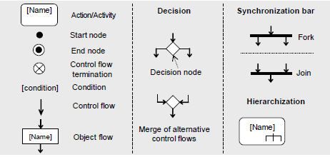
Requirements Modeling in the Functional Perspective
Modeling Elements of Activity Diagrams
Action Nodes
Control flows, object flows, responsibilities

Slide 47
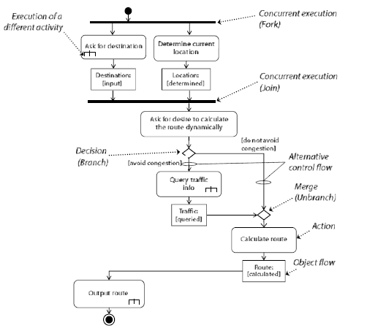
Requirements Modeling in the Functional Perspective
Activity diagram in
UML notation
Example

Slide 48
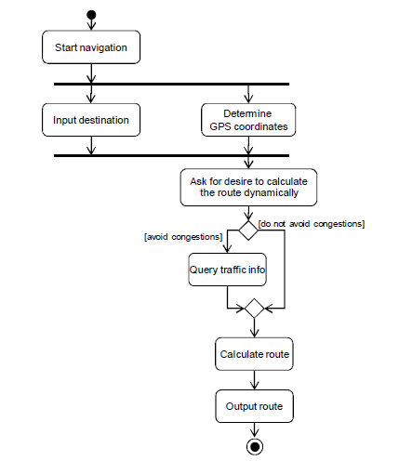
Requirements Modeling in the Functional Perspective
Activity Diagram
Control Flow of
Main and
Alternative Scenarios
Example

Slide 49
Requirements Modeling in the Behavioral Perspective
Finite-state automata
To model the dynamic behavior of a system, modeling approaches based on automata theory are typically employed.
The definition of a finite-state automaton comprises a set of states and a set of transitions that, dependent on the current state of the automaton, are performed given some event.

Slide 50
Requirements Modeling in the Behavioral Perspective
Mealy and Moore automata
In the scope of system modeling, extensions of finite-state automata are frequently used that are based on the concepts of so-called Mealy [Mealy 1955] and Moore automata [Moore 1956], respectively.
In Mealy automata, the output of an automaton depends on the current state of the automaton as well as on the input. In contrast, in Moore automata, the output merely depends on the current state.

Slide 51
Requirements Modeling in the Behavioral Perspective
State charts
Due to challenges that arise when using finite state automata in practice (such as missing support for abstraction), the automata concept has been developed into a technique of modeling the reactive behavior of a system.
A widely applied technique to model the behavior of a system is the use of statecharts [Harel 1987]. Statecharts are a type of automata that is based on finite-state automata but are extended to support hierarchization of states to document conditions of state transitions and to model concurrent behavior.
Statecharts = state machines + hierarchization + conditions + concurrency

Slide 52
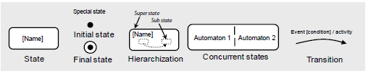
Requirements Modeling in the Behavioral Perspective
Modeling Elements of State Chart
State
Transition with condition and activity
Hierarchization and abstraction
Concurrency
Transition into super state

Slide 53
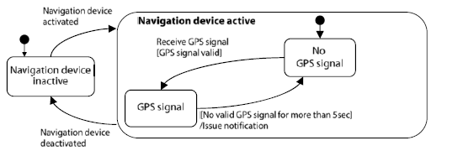
Requirements Modeling in the Behavioral Perspective
Simplified statechart of a vehicular navigation device Example

Slide 54
Requirements Modeling in the Behavioral Perspective
UML State Diagrams
Modeling reactive behavior of a system using UML
In order to model reactive system behavior, Unified Modeling Language (UML) [OMG 2007] offers so-called state machines that are essentially based on statecharts.
The notation of the modeling elements of UML state diagrams has largely been adopted from statecharts. However, UML 2 extends the modeling elements of statecharts, e.g., by the ability to define explicit entry and exit points of hierarchical states [OMG 2007].

Slide 55
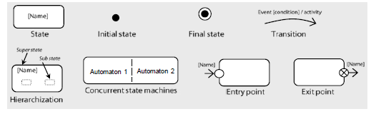
Requirements Modeling in the Behavioral Perspective
Modeling Elements of State Chart
States and transitions
Hierarchization and concurrency
Encapsulation of internal states using entry and exit points

Slide 56
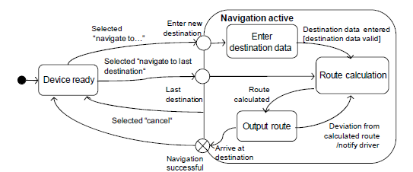
Requirements Modeling in the Behavioral Perspective
Example State diagram in UML 2 notation

Slide 57
Summary
Along with using natural language to document requirements, requirements can be documented by means of models. Typically, natural language requirements and requirements models are frequently employed in conjunction so that the advantages of both forms of documentation can be exploited.
Model-based documentation of requirements has, among other things, the advantage that graphical (imagelike) descriptions of circumstances can be understood faster and better than natural-language descriptions.
Among the models that are frequently used in requirements engineering are goal models (e.g., in the form of AND/OR trees) and use case diagrams as well as conceptual models to document requirements from three perspectives: data, functional, and behavioral.
For each of these three perspectives, there are suitable conceptual modeling languages that provide purpose-specific means to document the information depicted in each respective perspective.

Slide 58
References
Pohl, Klaus. Requirements engineering: fundamentals, principles, and techniques.(Chapter 6).

